Slide 1
SDL Trados Studio
Translating Different File Formats
Creating Projects

Slide 2
Easy!
SDL Trados Studio 2014 supports many file formats, some of which need preparation. For details see http://producthelp.sdl.com/sdl%20trados%20studio/client_en/File_Types/Preparing_Files.htm.
You can manually change the settings for processing different file formats under Project settings – File types.

Slide 3
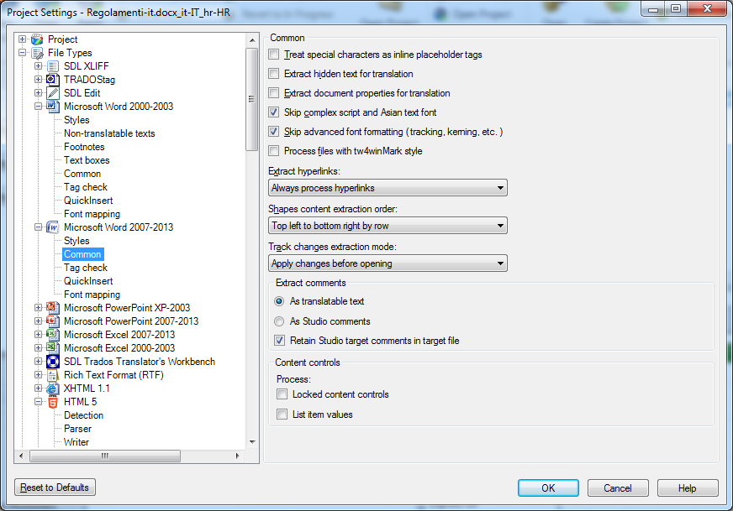

Slide 4
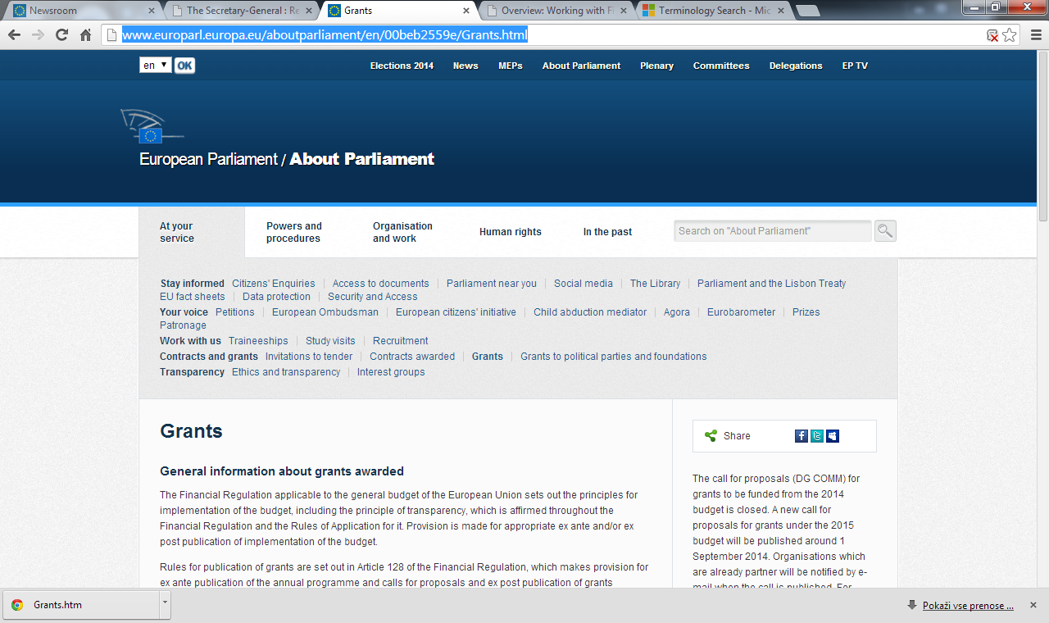
Save as...
Web page, complete

Slide 5
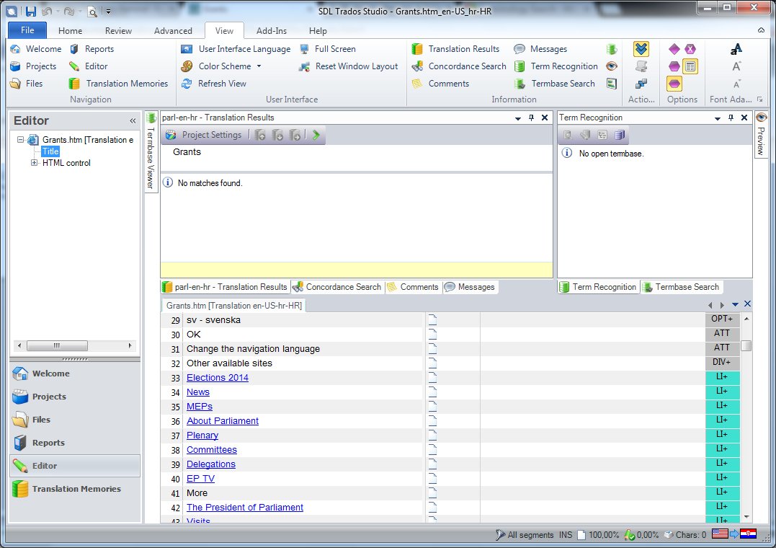

Slide 6
Exercise I
Go to http://www.europarl.europa.eu/aboutparliament/en/002084aa7c/Study-visits.html.
Switch to your source language (FR-IT-ES-EN-DE).
Save page as "Web page, complete".
Open HTML file in Studio 2014 and translate it using the TM created before.
Save target and preview in browser.

